Slide 1

Blood Donation
-Fenil Desani
-Sujay Sanglikar
-Aakib Ladhani

Slide 2

outline
Application Scope
UI Design
Framework
Task Division
Timeline
Conclusion

Slide 3
WHY DONATE BLOOD?
Safe blood saves lives and improves health.
There is a constant need for regular blood supply because blood can be stored for only a limited time before use.
Blood transfusion is needed for:
children with severe anaemia
people with severe trauma following man-made and natural disasters
many complex medical and surgical procedures and cancer patients
women with complications of pregnancy
people with conditions such as thalassaemia and sickle cell diseasE

Slide 4
WHY DONATE BLOOD?
Blood is the most precious gift that anyone can give to another person — the gift of life. A decision to donate your blood can save a life, or even several if your blood is separated into its components — red cells, platelets and plasma — which can be used individually for patients with specific conditions.

Slide 5
BLOOD BY NUMBERS
Every two seconds someone in the U.S. needs blood.
Approximately 36,000 units of red blood cells are needed every day in the U.S
Nearly 7,000 units of platelets and 10,000 units of plasma are needed daily in the U.S.
Nearly 21 million blood components are transfused each year in the U.S.
The average red blood cell transfusion is approximately 3 pints

Slide 6
BLOOD BY NUMBERS
According to the American Cancer Society, more than 1.69 million people are expected to be diagnosed with cancer in 2017. Many of them will need blood, sometimes daily, during their chemotherapy treatment.
A single car accident victim can require as many as 100 pints of blood.
It is estimated that sickle cell disease affects 90,000 to 100,000 people in the U.S. About 1,000 babies are born with the disease each year. Sickle cell patients can require frequent blood transfusions throughout their lives.

Slide 7
Application Scope
Using the blood donation app, people can see nearby donation drive, keep track of donations, And know more about donation process.
Every user will be able to register and login to the app by providing the login credentials.
Maps will be provided to find the nearest donation center.
A card will be provided to the donor, stating all the basic details such as Name, Age, Blood group, etc.

Slide 8
APPLICATION SCOPE (Contd…)
After the donation is done, a receipt will be sent to the recipient and a certificate will be given to the blood donor.
Donors will receive a message, when he/she is ready to donate the blood again.
Donor can keep track of the blood once he/she finish with donation.

Slide 9
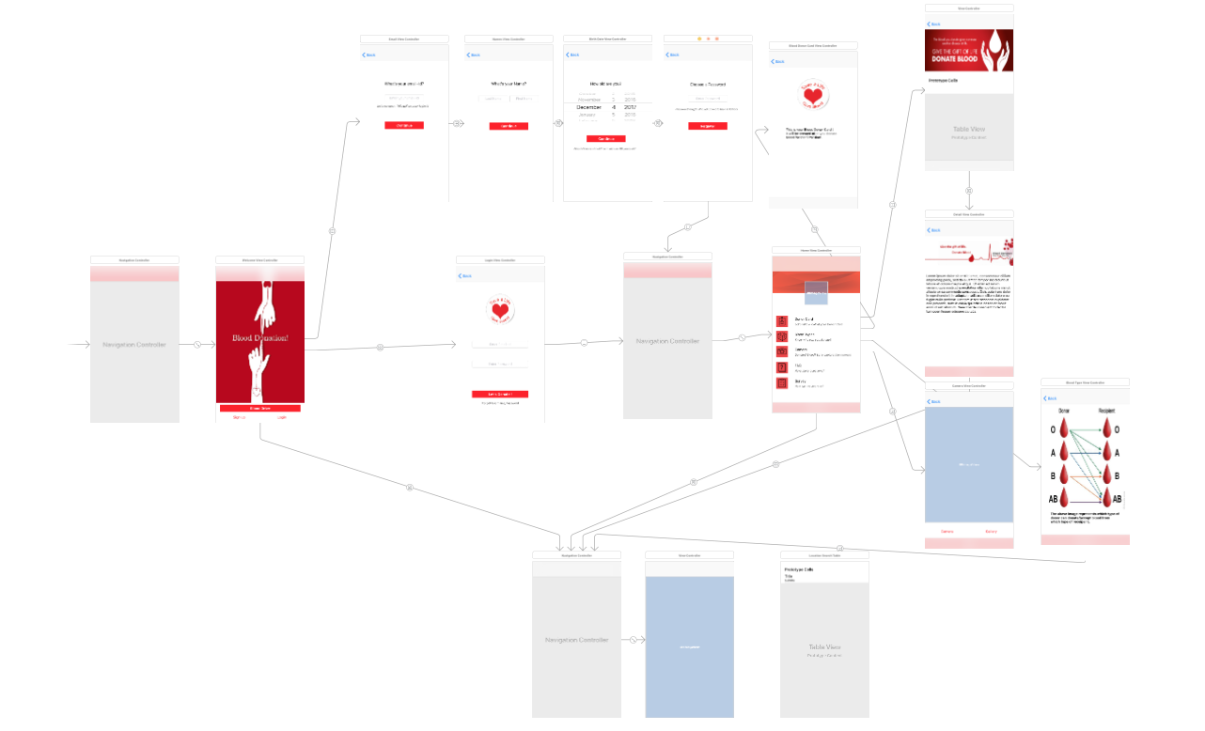
UI DESIGN

Slide 10
Framework
The basic framework for implementing this application includes:
Cocoa Touch framework
UIKit.framework
Foundation.framework
CoreGraphics.framework
MapKit.framework
AWS ios Sdk
MessageUI.framework

Slide 11
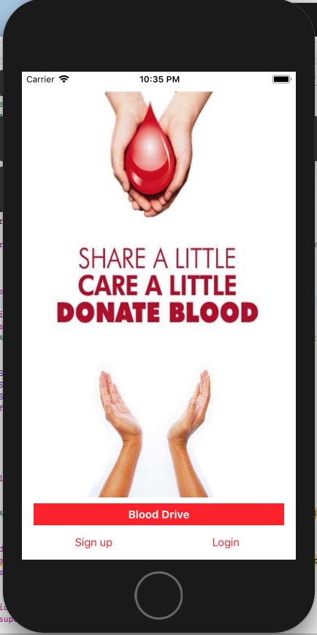
Welcome View

Slide 12
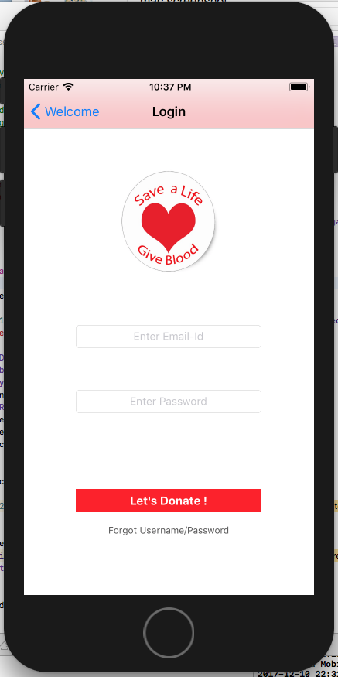
Login View

Slide 13
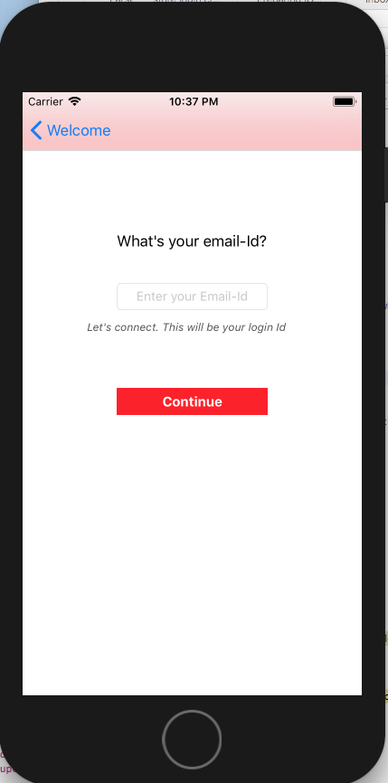
New Registration View

Slide 14
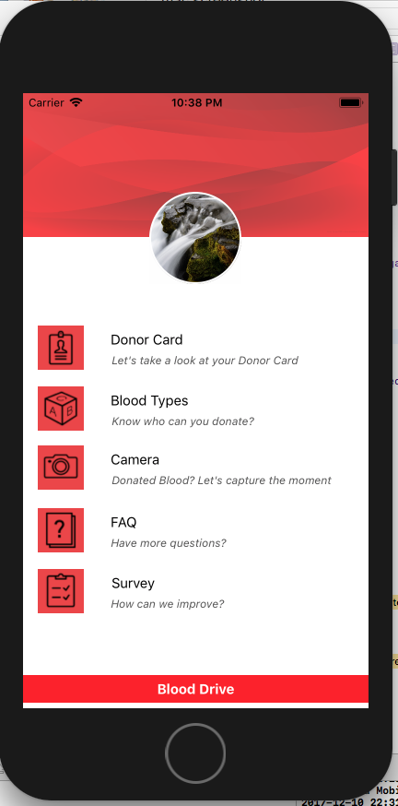
Donor Home page view

Slide 15
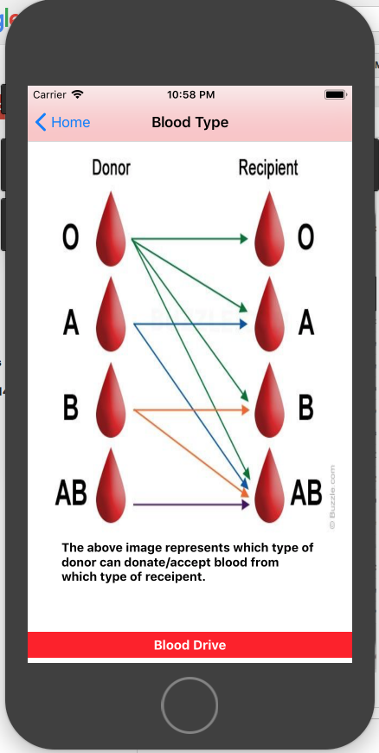
Blood Type view

Slide 16
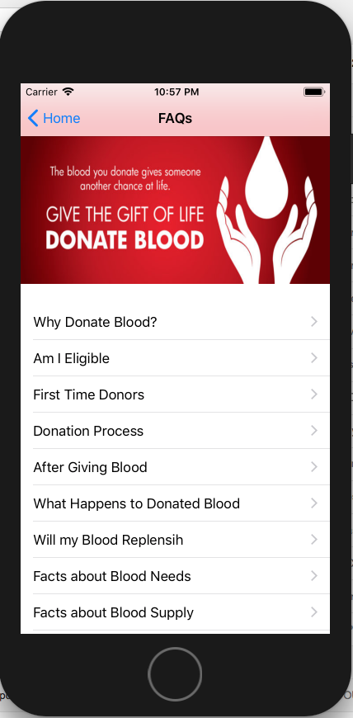
FAQ

Slide 17
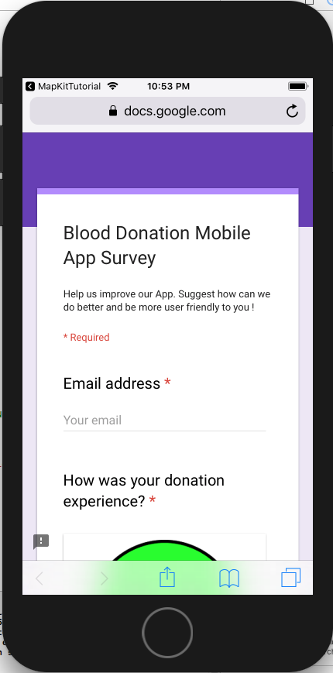
Survey

Slide 18
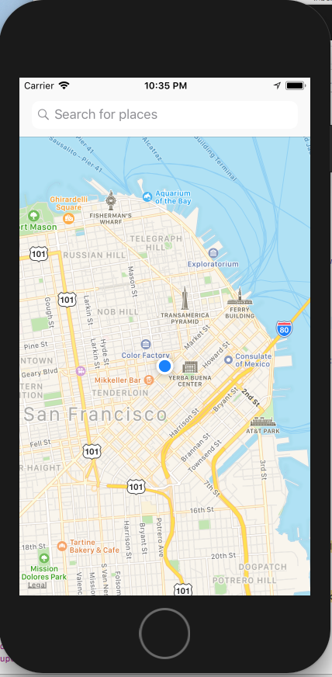
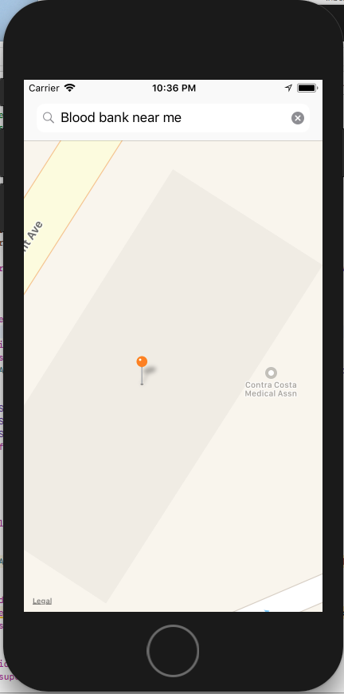
Blood Drive (Map view)

Slide 19
TASK DIVISION
FAQ – Sujay
Database Connection – Aakib
MapVeiw – Fenil
About Blood Donation – Sujay
Blood Drive– Fenil
Verification – Aakib
Blood Donor View – Fenil
ReportView - All

Slide 20
TImeline
Feature | Start Date | End Date
Wireframes/Mockups | September 13 | September 27
UI Design | September 13 | September 27
DB Design | September 28 | October 4
DB Creation | September 28 | October 4
Email Template Creation | October 5 | October 6
HomeScreenView(Development) | October 7 | October 13
Login View User Verification Forgot Password Change Password | October 14 | October 20
RegisterView Phone & Email Verification Saving user details | October 21 | November 4

Slide 21
Timeline(Contd..)
Feature | Start Date | End Date
Verification and Validation | November 5 | November 14
Blood Drive | November 15 | November 31
Connecting with AWS | December 1 | In Progress

Slide 22
Conclusion
Challenges faced
AWS integration
Integration of camera functionality from the application
Map view for the blood drive
Due to lack of affiliation with any organization many key aspects are not accommodated (tracking blood, Medical History, Donor card, etc )

Slide 23
Conclusion
New concept learnt
Converting code from objective-c to swift and vice versa
Integration of map kit framework
Camera integration
Successful implementation of topics like table view, map view, navigation controller learned in the course
Beginner guide to integrate aws

Slide 24
Future Scope
Complete user management through Aws cognito
Use of filters before sharing images to social media
Using api from established organization to find nearby drive conducted by them (typically not visible through simple search)
Digital blood donor card
Donation history of user

Slide 25

THANK YOU…!

